Slide 1
Interrupt using arduino
EMBEDDED SYSTEMS
CS427

Slide 2
intro
Interrupts are useful for making things happen automatically in microcontroller programs and can help solve timing problems.

Slide 3
What is Interrupts?
An interrupt is a signal that is generated by hardware or software when a process or an event needs immediate attention.
• Sources of Interrupts.
Hardware:
Types:
It is an electronic signal sent from an external device, or from an internal peripheral (Timer, ADC, ...).
Maskable: These interrupts can be enabled or disabled by software.
Non-Maskable: These interrupts can not be disabled.
Software:
Types:
It is caused either by an exceptional condition or a special instruction in the instruction set.
Exceptions.

Slide 4
ISR – interrupt service routine
ISRs are special kinds of functions that have some unique limitations most other functions do not have. An ISR cannot have any parameters, and they shouldn’t return anything.
It is a function that takes void and returns void.
It must contain small logic.
It is not called by the software.
It mustn't be optimized by the compiler.

Slide 5
ISR – interrupt service routine
global variables are used to pass data between an ISR and the main program. To make sure variables shared between an ISR and the main program are updated correctly, declare them as volatile.

Slide 6
Interrupt syntax
Declare interrupt pin
attachInterrupt(digitalPinToInterrupt(pin), ISR, mode)
Parameters
interrupt: the number of the interrupt. Allowed data types: int.
pin: the Arduino pin number.
ISR: the ISR to call when the interrupt occurs; this function must take no parameters and return nothing. This function is sometimes referred to as an interrupt service routine.
mode: defines when the interrupt should be triggered.

Slide 7
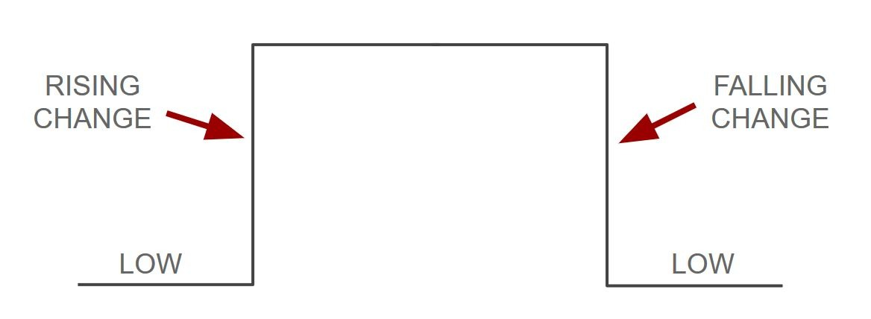
Interrupt syntax
Four constants are predefined as valid values:
LOW to trigger the interrupt whenever the pin is low,
CHANGE to trigger the interrupt whenever the pin changes value
RISING to trigger when the pin goes from low to high,
FALLING for when the pin goes from high to low.

Slide 8
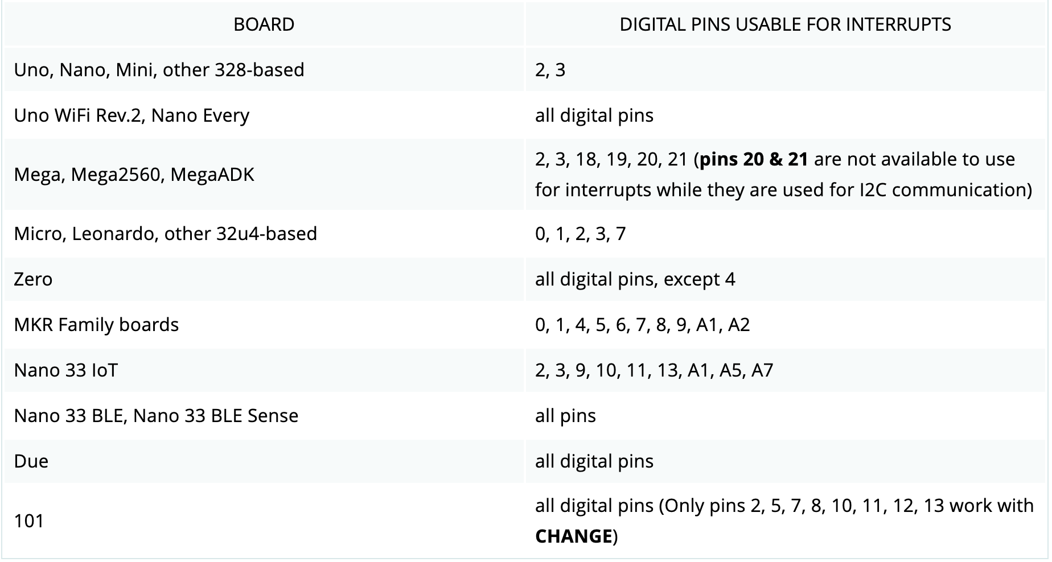
Interrupt syntax
digitalPinToInterrupt(pin)
translate the actual digital pin to the specific interrupt number

Slide 9
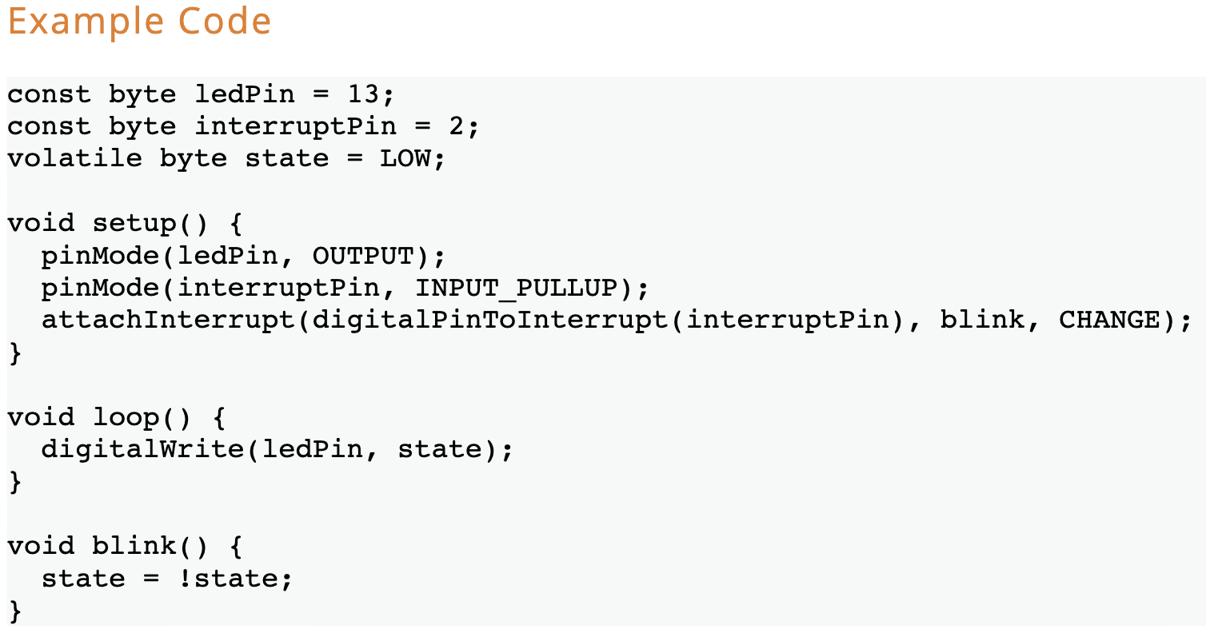
Interrupt syntax
https://wokwi.com/projects/new/arduino-uno

Slide 10
Example 2
1. Hardware Requirements
1. Three LEDs (LED1, LED2, LED3)
2. One button (BUTTON0)
2. Software Requirements
1. Initially, all LEDs are OFF
2. Once BUTTON0 is pressed, LED0 will be ON
3. Each press further will make another LED is ON
4. At the fifth press, LED0 will changed to be OFF
5. Each press further will make only one LED is OFF
6. This will be repeated forever
7. The sequence is described below
1. Initially (OFF, OFF, OFF)
2. Press 1 (ON, OFF, OFF)
3. Press 2 (ON, ON, OFF)
4. Press 3 (ON, ON, ON)
5. Press 4 (OFF, ON, ON)
6. Press 5 (OFF, OFF, ON)
7. Press 6 (OFF, OFF, OFF)
8. Press 7 (OFF, OFF, OFF)

Slide 11
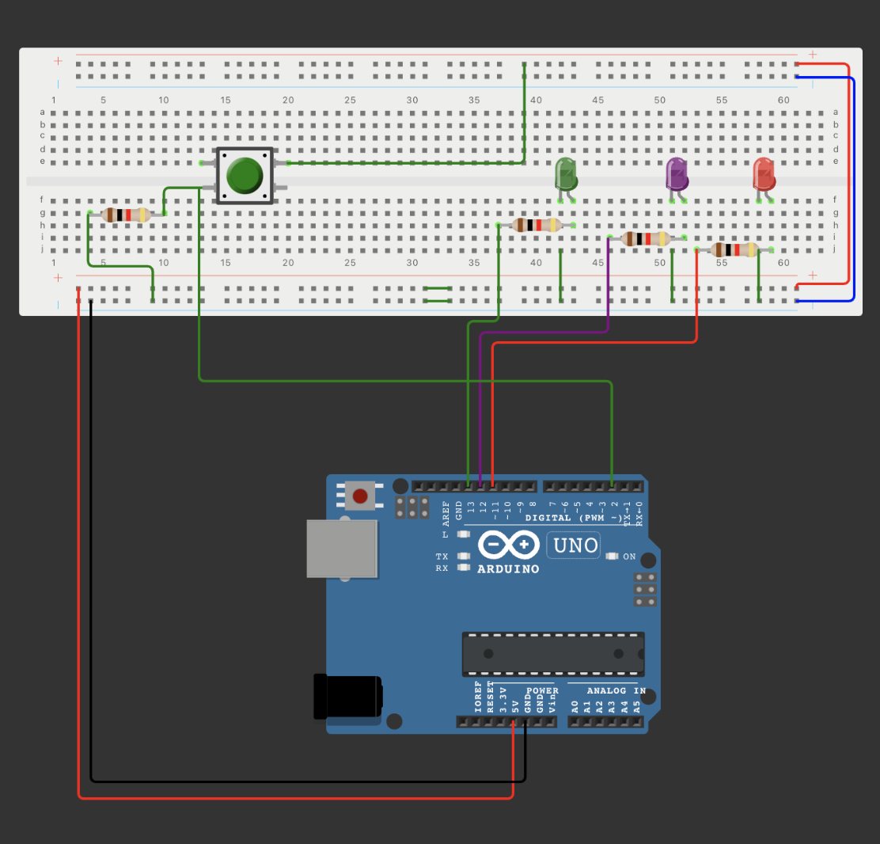
Example 2
CONNECTION

Slide 12
Example 3
1. Hardware Requirements
1. Three LEDs (LED1, LED2, LED3)
2. two button (BUTTON0, BUTTON0)
2. Software Requirements
1. Initially, all LEDs are OFF
2. Once BUTTON0 is pressed, LED0 will be ON
Each press on BUTTON0 further will make another LED is ON
When BUTTON1 is pressed then the LEDs prigntess with change (3 modes – 100%, 50%,10%)
4. At the fifth press, LED0 will changed to be OFF
5. Each press further will make only one LED is OFF
6. This will be repeated forever
7. The sequence is described below
1. Initially (OFF, OFF, OFF)
2. Press 1 (ON, OFF, OFF)
3. Press 2 (ON, ON, OFF)
4. Press 3 (ON, ON, ON)
5. Press 4 (OFF, ON, ON)
6. Press 5 (OFF, OFF, ON)
7. Press 6 (OFF, OFF, OFF)
8. Press 7 (OFF, OFF, OFF)

Slide 13
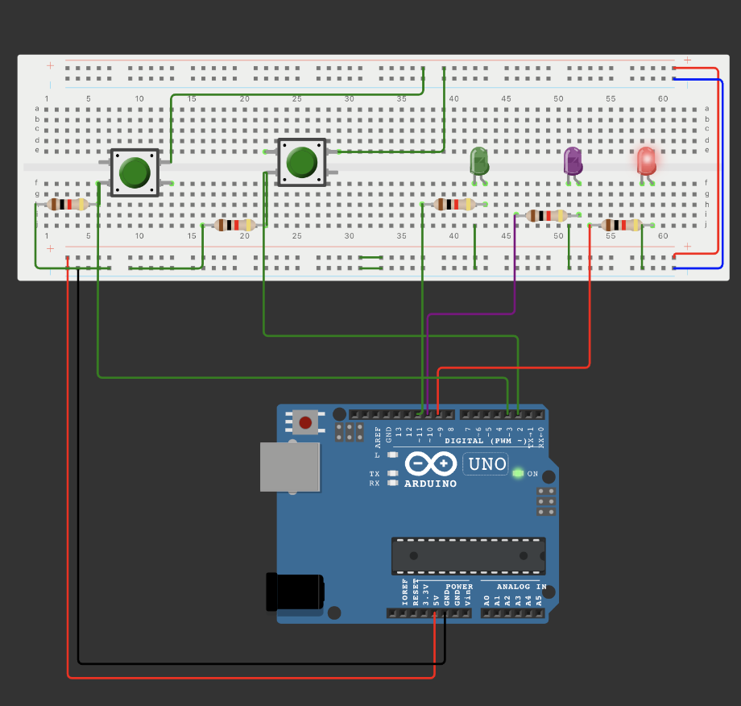
Example 3
CONNECTION

